Slide 1
Normal Stress Developing in Magnetorheological (MR) Fluids.
Nikki Cain
Northern Arizona University
Mentor: Constantin Ciocanel, PhD
Department of Mechanical Engineering

Slide 2
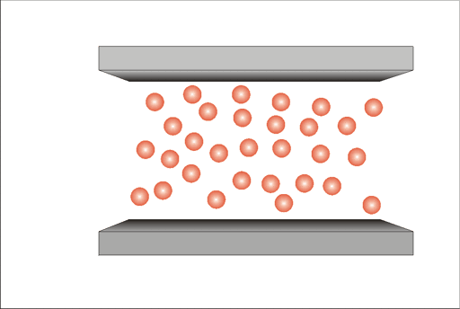
Background
Understand the normal stress developing in magnetorheological fluids (MRF)
MRF
Smart material made of a carrier fluid and iron-based micron size particles
Magnetic field yields an apparent viscosity increase
What is known:
Shear force on particle chains
Flow mode “Valve Mode”
What is sought:
Normal force on particle chains
“Squeeze Mode”
Figure 1: MRF particles reacting to magnetic field application [1]

Slide 3
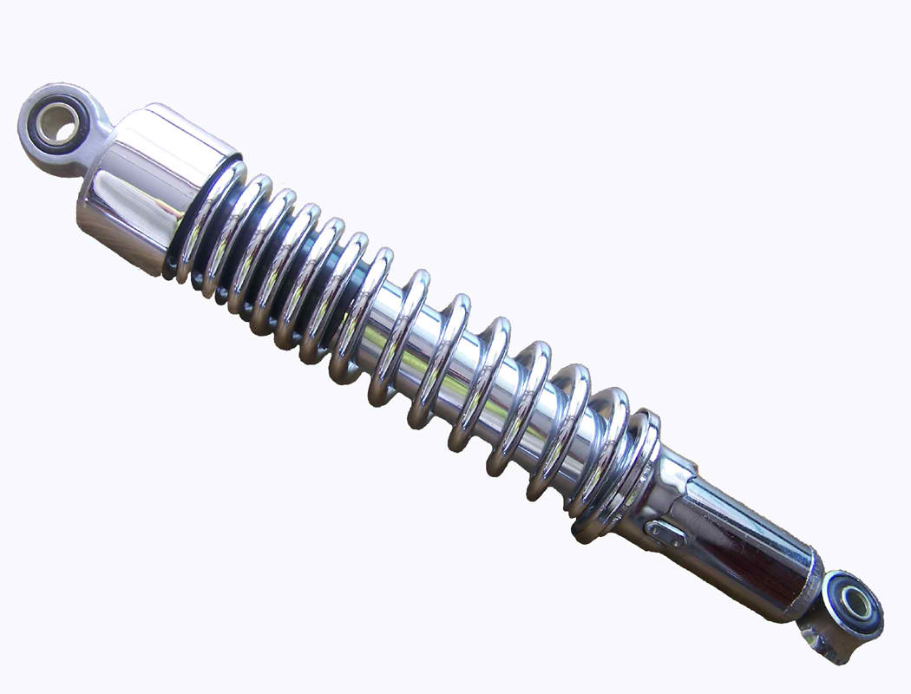
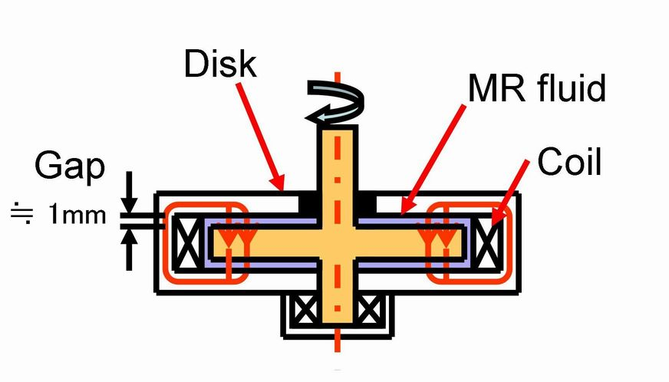
Applications of MRF
Flow Mode
Shock absorbers
Shear Mode
Clutches and Breaks
Squeeze Mode
Controlling small movements
Large forces
Figure 2: MRF Shock absorber [2]
Figure 3: MRF Clutch/break design [3]

Slide 4
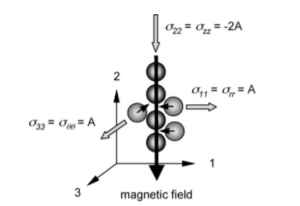
Introduction
Determine magnitude of the normal stress as a function of magnetic field strength, gap size, temperature, and frequency of squeezing
Others have attempted to validate normal force models with experimental data
Normal stress and normal forces
Yielding behavior and stress differences
Model predictions will be compared to experimental data
Figure 4: MRF Chain Model and Normal Force Equation [4]

Slide 5
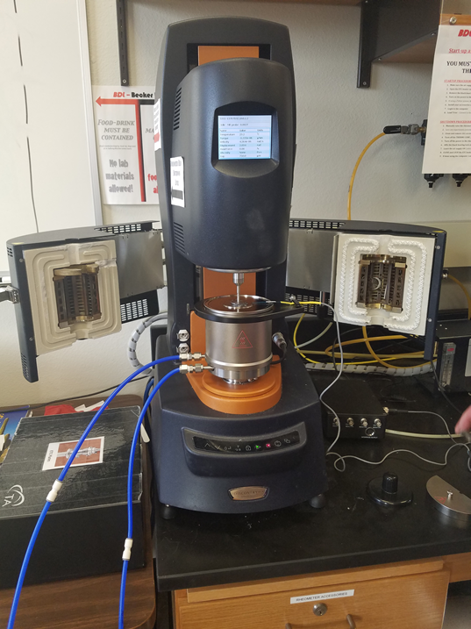
Experiment
Rheometer
Laboratory device used to measure fluid properties such as viscosity, shear stress and normal stress
Magnetorheological accessories/electromagnet
Gaussmeter
Measures magnetic field strength
Thermocube
Electromagnet’s cooling unit
Measure the normal stress that develops in different amounts of fluid exposed to different magnetic field strengths.
Figure 5: Rheometer with MRF loaded between the plates.

Slide 6
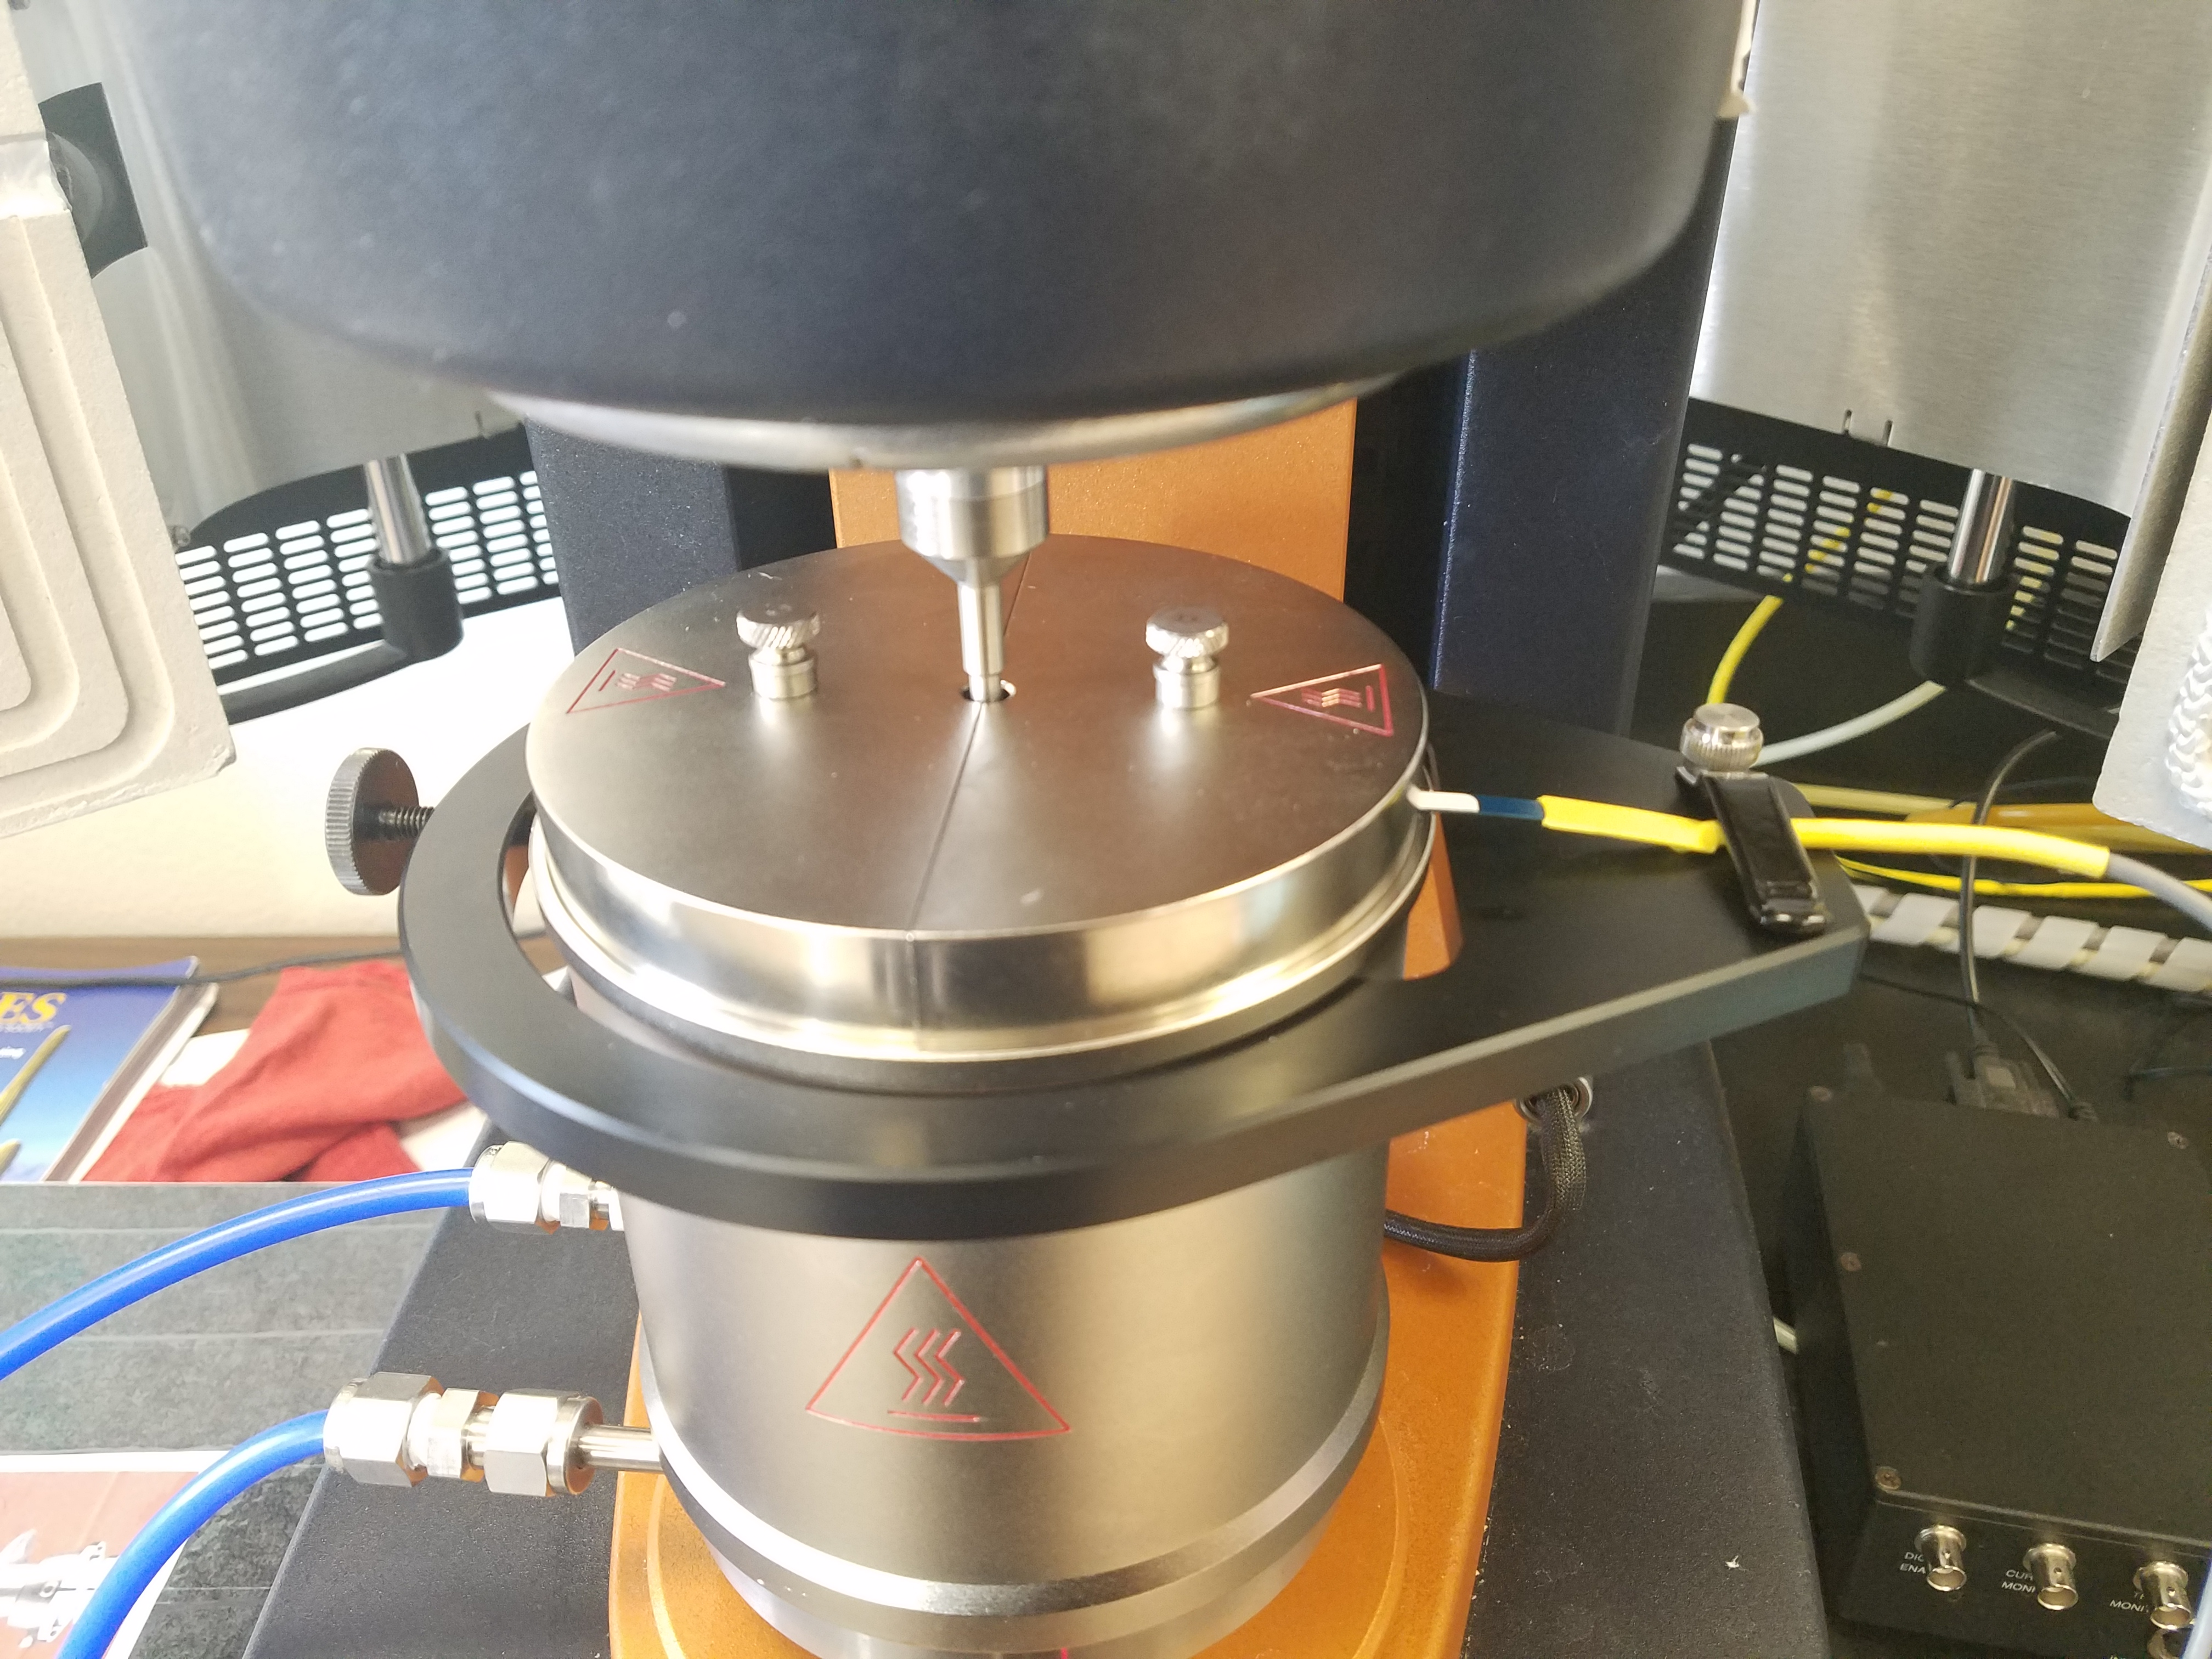
Experiment
Gaussmeter
MRF’s enclosure
Coolant lines
Electromagnet/
Lower plate
Figure 6: MRF Enclosure ready for testing

Slide 7
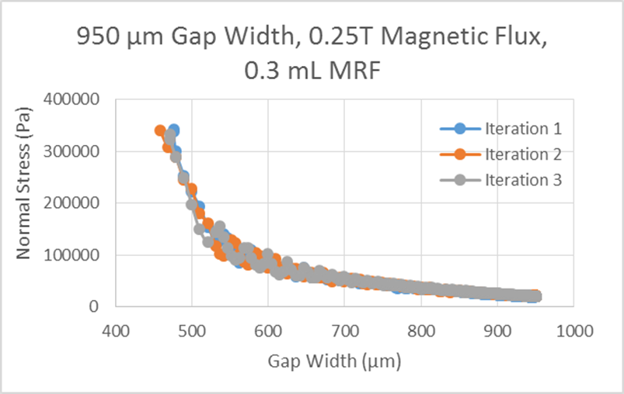
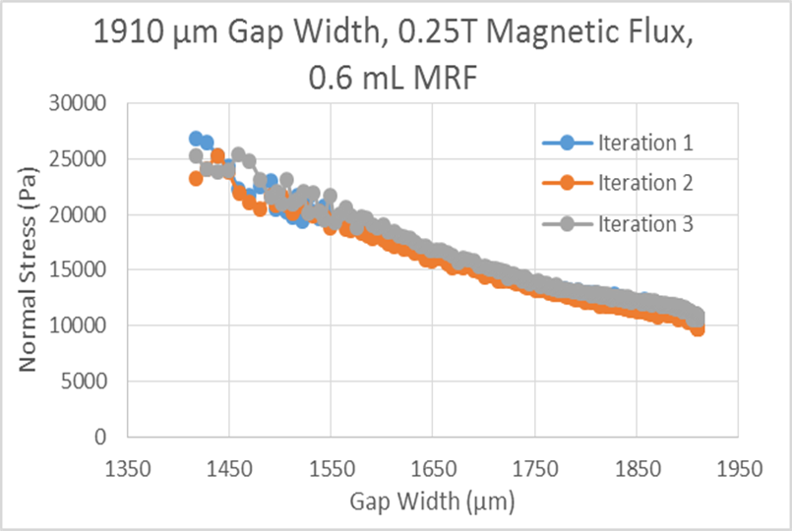
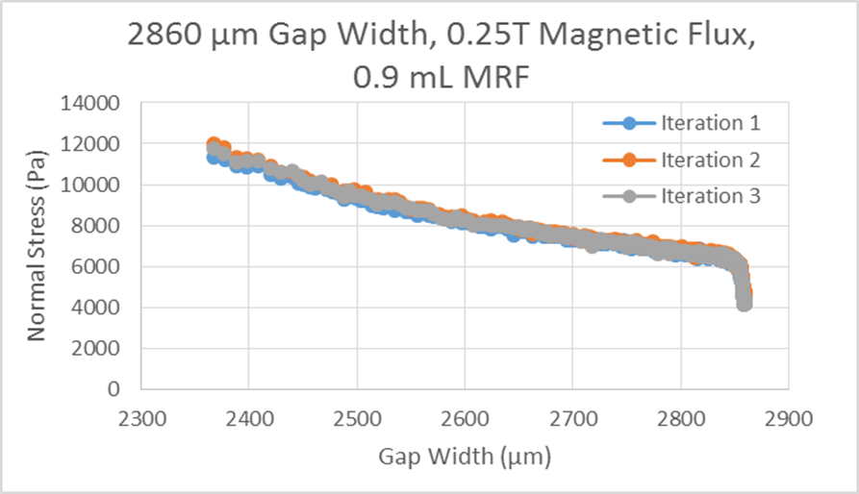
Results
- Gap effect on Normal stress magnitude
0.3 mL MRF, 0.25T, 950μm max gap
0.6 mL MRF, 0.25T, 1910μm max gap
0.9 mL MRF, 0.25T, 2860μm max gap

Slide 8
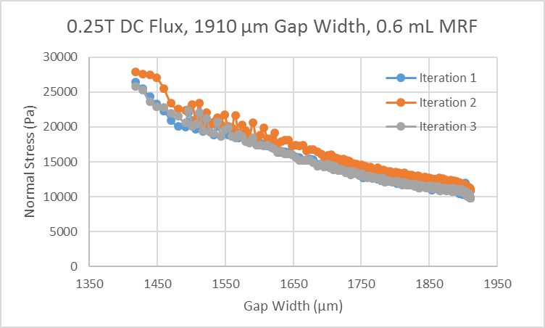
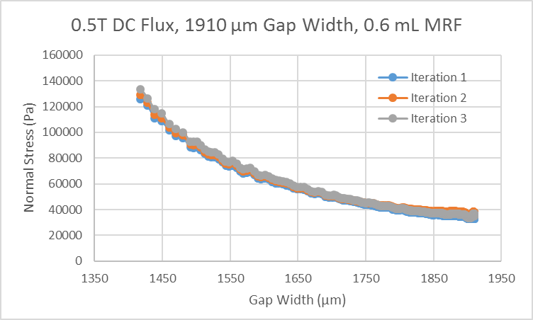
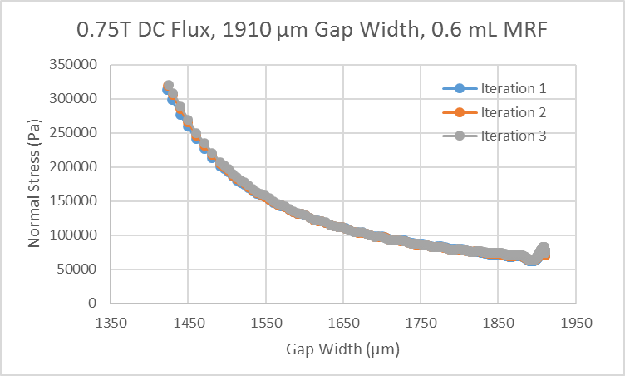
Results
- Field effect on Normal stress magnitude in 0.6 mL of fluid
0.6 mL MRF, 0.25T, 1910μm max gap
0.6 mL MRF, 0.5T, 1910μm max gap
0.6 mL MRF, 0.75T, 1910μm max gap

Slide 9
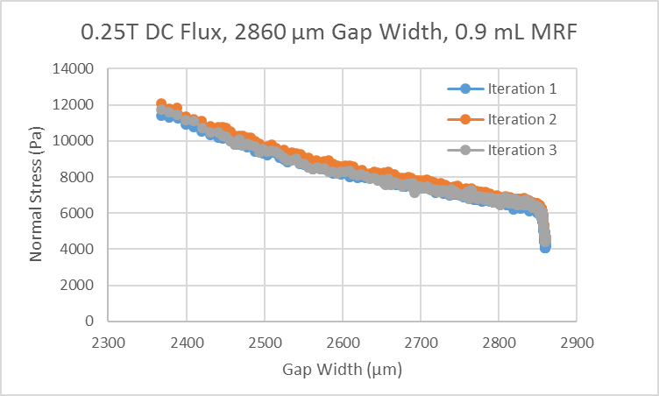
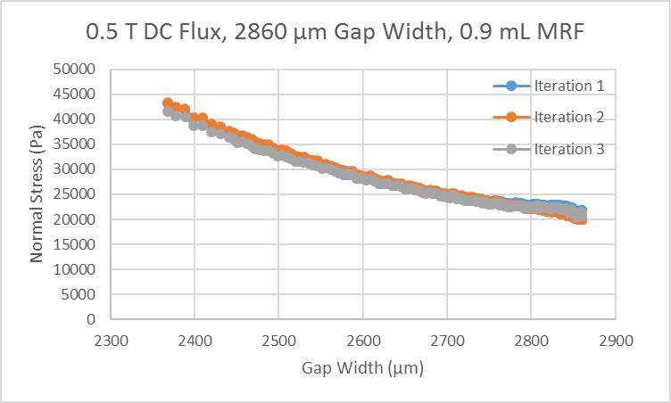
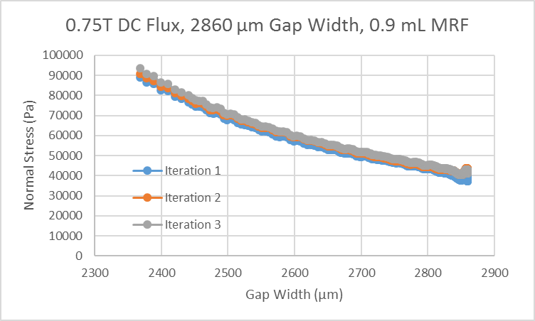
Results
- Field effect on Normal stress magnitude in 0.9 mL of fluid
0.9 mL MRF, 0.25T, 2860μm max gap
0.9 mL MRF, 0.5T, 2860μm max gap
0.9 mL MRF, 0.75T, 2860μm max gap

Slide 10
Conclusions
What was found
The smaller the gap and the higher the field, the larger the normal stress
Decreasing the gap below 1.4 mm doesn’t yield a much higher increase in normal stress, but limits the travel of the boundaries squeezing the fluid, hence limiting the range of applications of the fluid
Moving Forward
Additional experimental data needs to be collected, particularly under oscillatory squeeze mode
Compare existing model predictions with experimental data for all analyzed cases and identify missing features in the model to allow for accurate predictions

Slide 11
Acknowledgements
NASA Space Grant and Arizona Space Grant Consortium
Constantin Ciocanel, PhD
Timothy Becker, PhD and William Merritt (Bill)

Slide 12
Questions?

Slide 13
References
[1]"MAGNETORHEOLOGICAL FLUIDS AND DEVICES", Mrfengineering.com.ua, 2018. [Online]. Available: http://mrfengineering.com.ua/en/magnitoreologicheskaya-zhidkost.
[2] "SHOCK ABSORBER PASSION REAR SET ENDURANCE- Motorcycle Parts For Hero Honda Passion", Safexbikes Motorcycle Superstore, 2018. [Online]. Available: https://safexbikes.com/productdetail/motorcycle-parts/shock-absorbers/hero-honda-passion/S135104407.
[3]"Research of Kikuchi Lab", Www2.hwe.oita-u.ac.jp, 2018. [Online]. Available: http://www2.hwe.oita-u.ac.jp/kikuchilab/Research/Research_eng.html.
[4] H. Laun, C. Gabriel and G. Schmidt, "Primary and secondary normal stress differences of a magnetorheological fluid (MRF) up to magnetic flux densities of 1T", Journal of Non-Newtonian Fluid Mechanics, vol. 148, no. 1-3, pp. 47-56, 2008.

